Slide 1

Prepared Today. Protected Tomorrow.
A comprehensive disaster preparedness and emergency response ecosystem.
Sanrakshan serves as a bridge between panic and safety.

Slide 2




Rooted in the Cultural Value of Collective Responsibility
The term 'Sanrakshan' originates from Sanskrit and Hindi, signifying Protection, Preservation, and Safeguarding.
The platform is a digital manifestation of the cultural imperative to protect life, community, and future generations.
Moving beyond reactive measures to foster a culture of proactive preparedness through structured learning and guided systems.

Slide 3






The Gap Between Disaster and Safety is Panic
Institutional Modernism
Unexpected Event
Panic & Confusion
Lack of Guidance
Casualty
The Reality
Disasters occur unexpectedly, but the immediate aftermath is defined by chaos.
Educational Deficits
Institutions lack interactive
preparedness systems.
Vulnerable Demographics
Children lack structured education; the public lacks accessible tools.

Slide 4
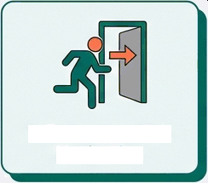


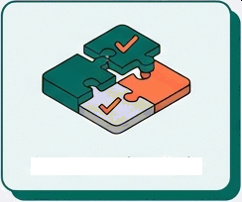
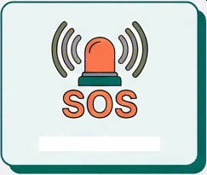
A Unified Platform for Preparedness and Response
1. Emergency Exit Navigation
2. Case Studies Section
sANRAxsxAN
Platform
3. Interactive Quiz
4. SOS Feature
Integrating four critical modules into a single accessible interface to create awareness, enhance readiness, and guide individuals through chaos.

Slide 5
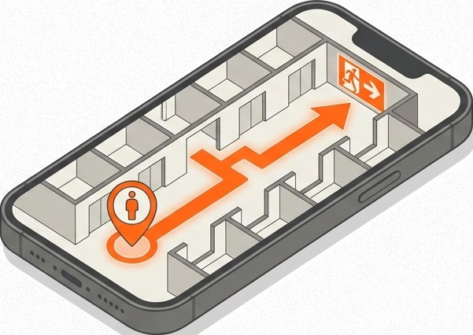
Navigating the Chaos: Emergency Exit Navigation System
Psychological Insight: In panic, people follow light.
The Function: Reduces confusion during evacuations by providing structured, accessible navigation paths.
Proof of Concept: Successfully designed and implemented a navigation model specifically for a single-floor university building, validating the core technology.
Future Vision: Integration of Augmented Reality
(AR) for real-time indoor navigation support.

Slide 6
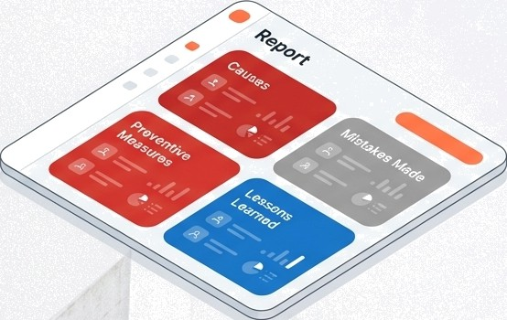
Proactive Education: Learning from the Past
The Shift: Moving beyond news reports to provide structured analysis of real-world disasters.
Analysis Structure:
Causes
Mistakes Made
Preventive Measures
Lessons Learned
Goal: Improves disaster understanding to
prevent history from repeating.
G NotebookLM

Slide 7
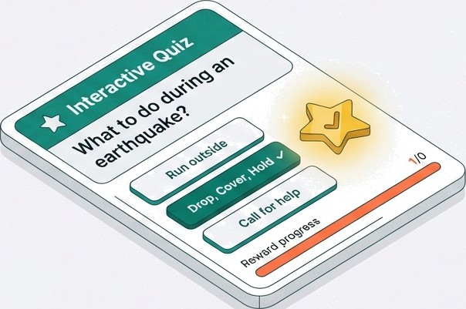
Gamified Engagement: Building Survival Muscle Memory
Target Audience: Tailored experiences for two distinct groups: General Public and School-level Children.
Mechanism: Ramification ensures retention and enhances engagement using interactive scenarios.
Objective: Focuses on practicing survival techniques rather than just memorizing them.

Slide 8

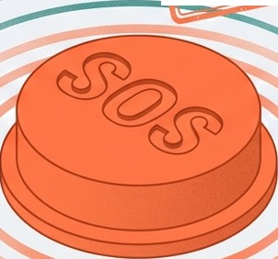

Real-Time Lifeline Connectivity
SOS Feature (In Development)
Function: Enables rapid emergency communication when seconds count.
The Transformation: Completes the ecosystem by providing a direct link to assistance, transforming the app from a
passive guide to an active tool for rescue.
Future Integration: Designed for live
collaboration with response authorities. ”

Slide 9
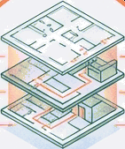
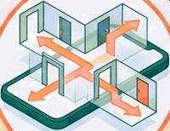
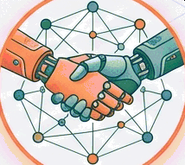

Technological Resilience and Evolution
Step 1
Step 2
Step 3
Step 4
I silienc‹ Mobile app deployment with offline functionality ensuring reliability without grid connectivity.
Infrastructure Scaling Advancing to complex multi-floor and
multi-building evacuation systems.
Next-Gen Navigation: Integration of AR-based (Augmented Reality) indoor navigation.
Integration Live emergency response integration to connect users with authorities instantly.

Slide 10









Operational Status: From Concept to Model
COMPLETED & DEPLOYED IN ACTIVE DEVELOPMENT
Case Studies Section: Fully developed with structured analysis protocols.
SOS Feature: Currently being engineered for rapid response integration.
Interactive Quiz Module: Live and tailored for both target demographics.
Navigation MVP: Single-floor university building model designed and implemented.

Slide 11
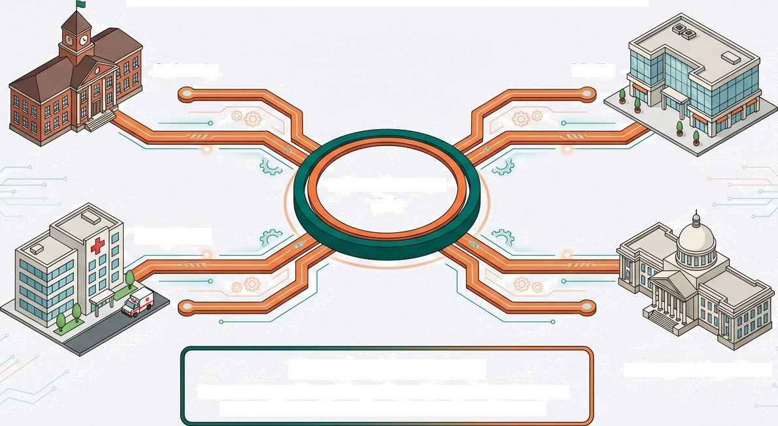
Expanding the Safety Ecosystem
Schools
Malls
SANRAKSHAN
Hub
Hospitals
Strategic Partnerships
Direct collaboration with disaster management authorities to align the platform with national safety protocols.
Public Institutions

Slide 12
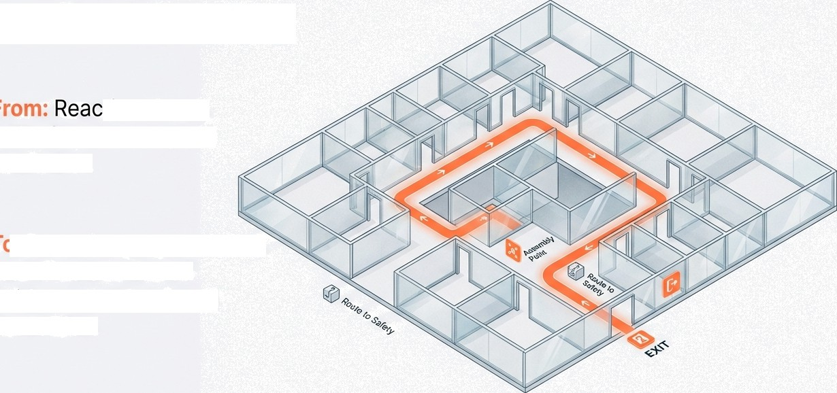
Bridging the Gap Between Panic and Safety
tive chaos, lack of awareness, and confusion.
Proactive preparedness, real-time structured guidance, and reduced casualties.
G

Slide 13





The Team Behind the Protection
Mohd. Sahil Ansari Disha Goyal
Syed Fatma Mohsin
Sanhita Banik
Utsav Basnet

Slide 14



Pre are ness
Be Practice
From Awareness to Action.
Join us in building a culture where every individual is prepared today, so they can be protected tomorrow.
SANRAKSHAN

